Slide 1


Motor System
Dr. Massra Ghassan Abdulkareem
Physiology Department
College of Medicine\ University of Basrah

Slide 2
Objectives
What is motor cortex
Main Motor cortex areas
Some specialized areas of motor cortex.
1

Slide 3
The motor cortex is the region of the cerebral cortex involved in the planning, control, and execution of voluntary movements.
University of Basrah-College of Medicine-Physiology Department
2

Slide 4
Motor Cortex
Anterior to the central cortical sulcus, occupying approximately the posterior one third of the frontal lobes,
It divided in to 3 Areas:
primary motor cortex
premotor area
supplementary motor area
University of Basrah-College of Medicine-Physiology Department
3

Slide 5
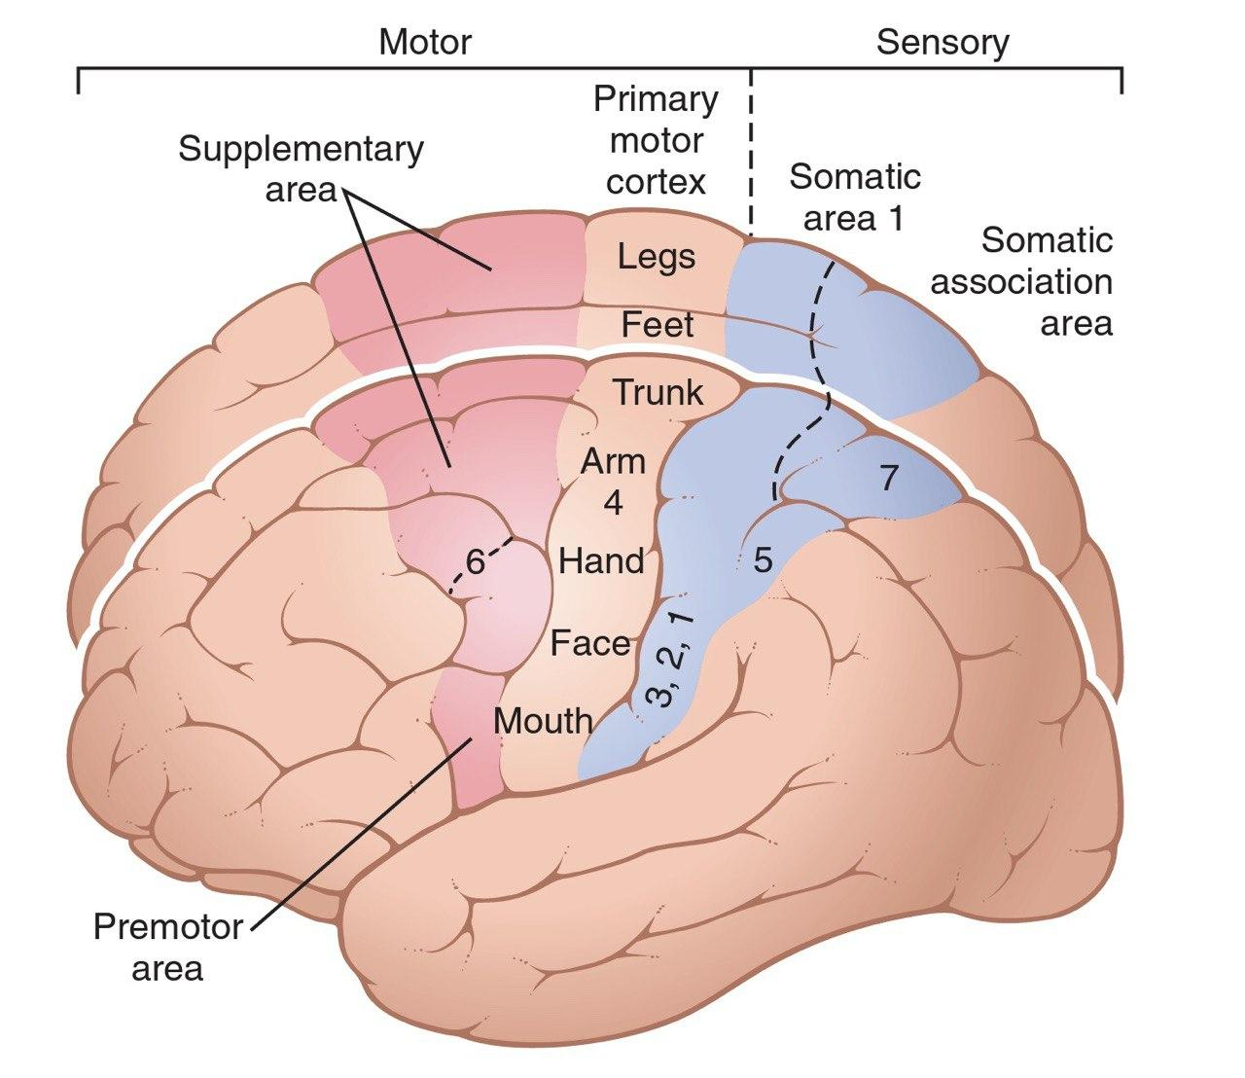
University of Basrah-College of Medicine-Physiology Department
4

Slide 6
Each has its own topographical representation of muscle groups and specific motor functions of the body.
University of Basrah-College of Medicine-Physiology Department
5

Slide 7
PRIMARY MOTOR CORTEX
lies in the first convolution of the frontal lobes anterior to the central sulcus
topographical representations of the different muscle areas of the body in the primary motor cortex
University of Basrah-College of Medicine-Physiology Department
6

Slide 8
University of Basrah-College of Medicine-Physiology Department
7

Slide 9
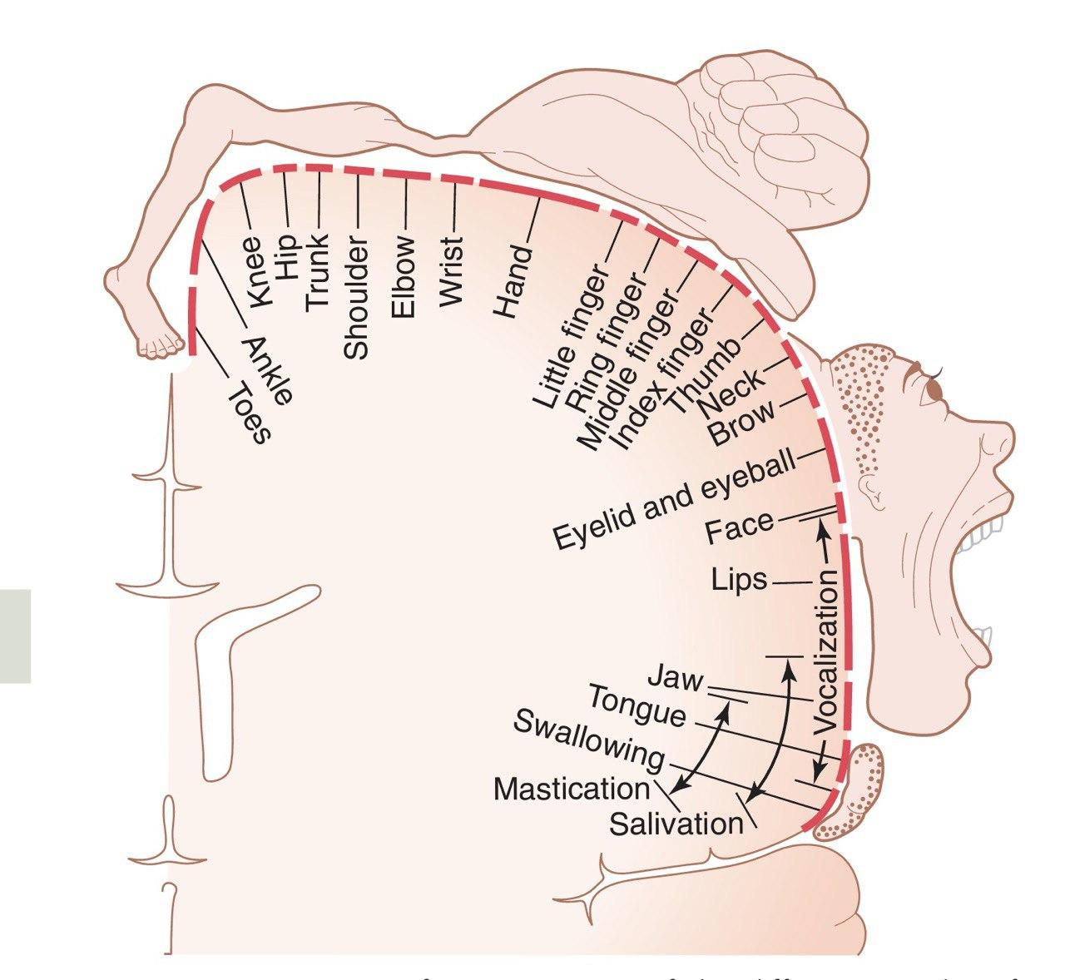
University of Basrah-College of Medicine-Physiology Department
8

Slide 10
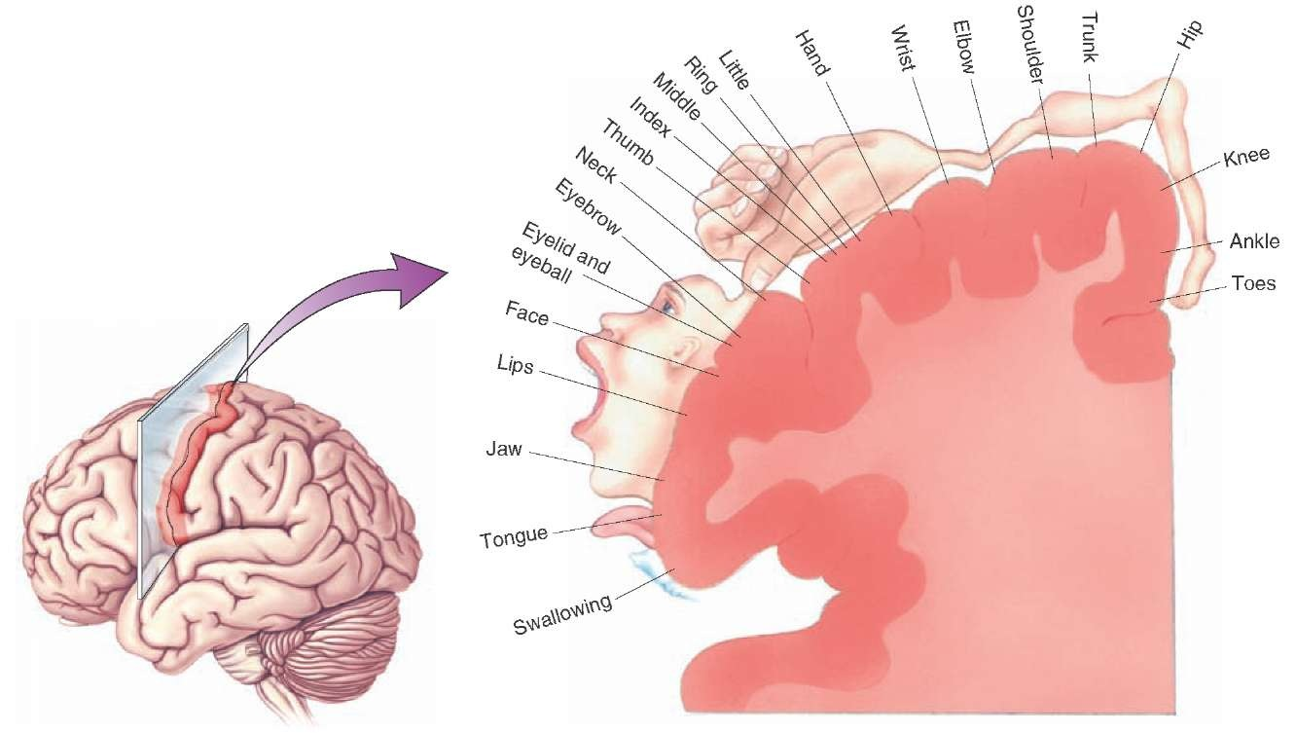
University of Basrah-College of Medicine-Physiology Department
9

Slide 11
Note that more than one half of the entire primary motor cortex is concerned with controlling the muscles of the hands and the muscles of speech.
excitation of a single motor cortex neuron usually excites a specific movement rather than one specific muscle.
Point stimulation in these hand and speech motor areas on rare occasion causes contraction of a single muscle, but most often, stimulation contracts a group of muscles.
University of Basrah-College of Medicine-Physiology Department
10

Slide 12
PREMOTOR AREA
lies 1 to 3 centimeters anterior to the primary motor cortex.
University of Basrah-College of Medicine-Physiology Department
11

Slide 13
University of Basrah-College of Medicine-Physiology Department
12

Slide 14
The topographical organization of the premotor cortex is roughly the same as that of the primary motor cortex, with the mouth and face areas located most laterally.
University of Basrah-College of Medicine-Physiology Department
13

Slide 15
Nerve signals generated in the premotor area cause much more complex “patterns” of movement than the discrete patterns generated in the primary motor cortex.
For instance, the pattern may be to position the shoulders and arms so that the hands are properly oriented to perform specific tasks.
University of Basrah-College of Medicine-Physiology Department
14

Slide 16
A special class of neurons called mirror neurons becomes active when a person performs a specific motor task or when he or she observes the same task performed by others.
Thus, the activity of these neurons “mirrors” the behavior of another person as though the observer was performing the specific motor task. Brain imaging.
University of Basrah-College of Medicine-Physiology Department
15

Slide 17
SUPPLEMENTARY MOTOR AREA
It extends a few centimeters onto the superior frontal cortex.
The supplementary motor area has yet another topographical organization for the control of motor function.
University of Basrah-College of Medicine-Physiology Department
16

Slide 18
University of Basrah-College of Medicine-Physiology Department
17

Slide 19
Contractions elicited by stimulating this area are often bilateral rather than unilateral. For instance, stimulation frequently leads to bilateral grasping movements of both hands Simultaneously.
this area functions in concert with the premotor area to provide body-wide attitudinal movements, fixation movements of the different segments of the body, positional movements of the head and eyes.
University of Basrah-College of Medicine-Physiology Department
18

Slide 20
SOME SPECIALIZED AREAS OF MOTOR CONTROL FOUND IN THE HUMAN MOTOR CORTEX
control specific motor functions.
University of Basrah-College of Medicine-Physiology Department
19

Slide 21
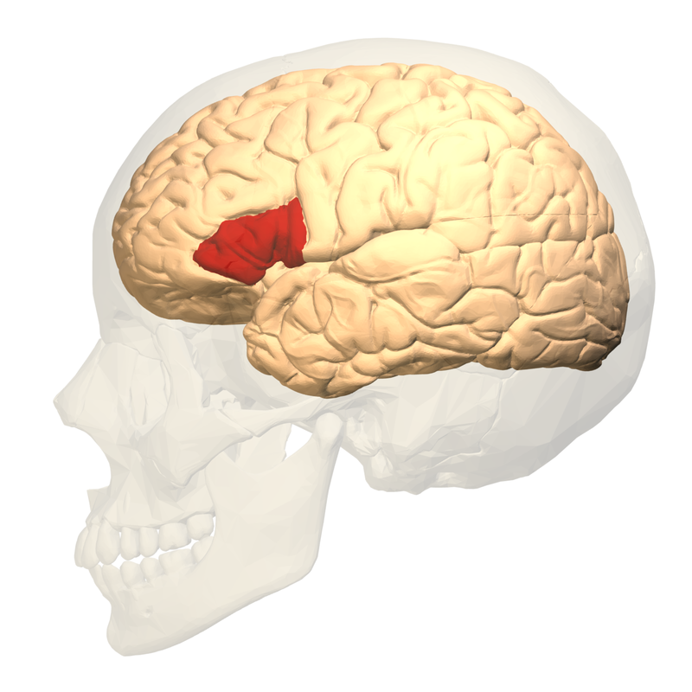
Broca’s Area (Motor Speech Area)
  It’s the site for expression of words by exciting
  simultaneously the laryngeal muscle, respiratory muscles and muscles of the mouth
  Damage to this area → motor aphasia
  Damage to this area does not prevent a person from vocalizing, but it does make it impossible for the person to speak whole words
University of Basrah-College of Medicine-Physiology Department
20

Slide 22
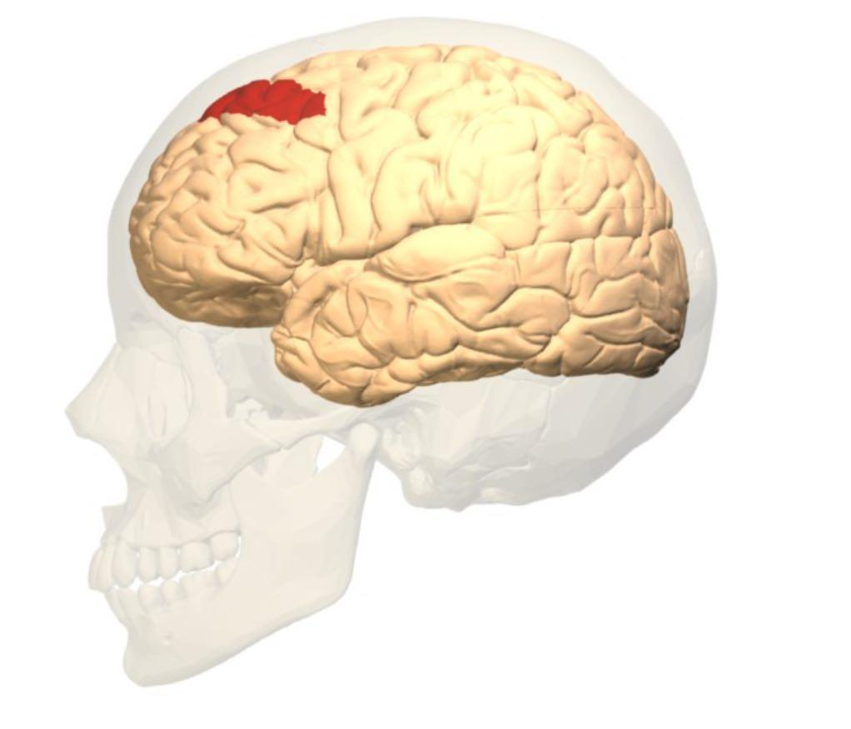
Voluntary” Eye Movement Field
  In the premotor area immediately above Broca’s area
a locus for controlling voluntary eye movements.
  Damage to this area prevents a person from
  voluntarily moving the eyes toward different objects.
University of Basrah-College of Medicine-Physiology Department
21

Slide 23
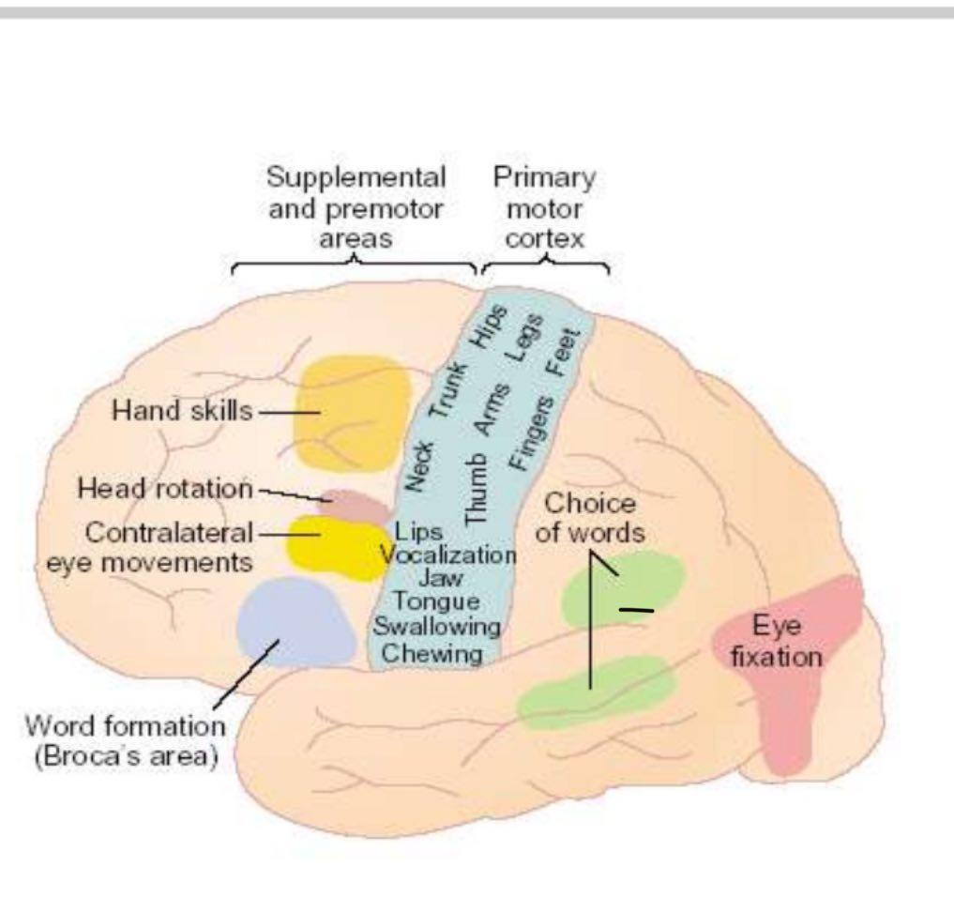
Head rotation area
Its closely associated with eye movement field and related to directing the head toward different objects.
University of Basrah-College of Medicine-Physiology Department
22

Slide 24
Area for hand skills
In the premotor area .
Is a region that is important for “hand skills.”
lesions cause destruction in this area, hand movements become uncoordinated and non purposeful,
a condition called motor apraxia
University of Basrah-College of Medicine-Physiology Department
23

Slide 25
Recap
Motor cortex: Anterior to the central cortical sulcus, occupying approximately the posterior one third of the frontal lobes.
PRIMARY MOTOR CORTEX,
PREMOTOR AREA
SUPPLEMENTARY MOTOR AREA
Broca’s Area (Motor Speech Area): expression of words.
Voluntary” Eye Movement Field: controlling voluntary eye movements.
Head rotation area: eye movement field and related to directing the head.
Area for hand skills( control hand movement).
24

Slide 26
Thank You

